Slide 1
Overview of Personal Management
Lecture # 1
Faiza Sharif

Slide 2
Background
Everyone has difficulties and challenges in life.
Sometimes they are small frustrations. Sometimes they are overwhelming.
In life we all meet people who appear to be more confident and happier than us.
What is their secret?
How come they can face each new day with optimism?
Is there something they do that we can do also?
The answer to this last question is YES!

Slide 3
Self-management – What is it?
There are many factors that influence how happy and confident a person becomes in life.
These usually include attitude, knowledge, specific skills, and effort.
For example, successful concert musician usually display a positive attitude toward what they do. They enjoy making music. They have gained knowledge by studying classical music. They have specific skills because they have learned how to play the piano. They have also applied much effort in practicing the piano regularly.
However, another factor that enables people to become happy and confident is learning how to control their reactions to life.
This is self-management.

Slide 4
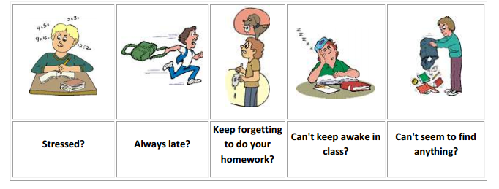
Do you ever see yourself in the following situations?

Slide 5
What is Personal Management?
Personal development is a lifelong process. It is a way for people to assess their skills and qualities, consider their aims in life and set goals in order to realize and maximize their potential.
These are the skills that are going to get you successfully through your day-to-day dealings.
YOU need to make appropriate decisions about your life. YOU are responsible for how you deal with the challenges and difficulties you face.
You may complain about them to your friends and neighbors, but in the end only YOU can do something about them.

Slide 6
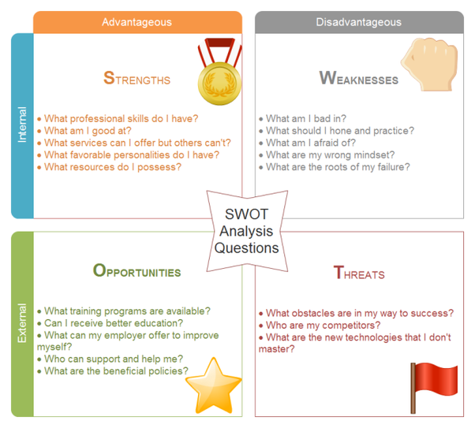
SWOT Analysis

Slide 7


Slide 8
Responsibilities
All of these scenarios require you to manage yourself on a daily basis.
Family Responsibilities
As a member of your family, you are constantly required to try to fit in and help out as best you can, whether it is taking care of pets, babysitting, or taking out the garbage, to list only a few.
School Responsibilities
At school there are many demands placed on you during the day: completing assignments, interacting with other adolescents and teachers, and learning new material in a variety of subject areas. The pressures associated with trying to fit in with a peer group can be overwhelming for some. You can probably relate to these challenges big time.
Taking Care Of Yourself With all of this, we have not even mentioned that there is also the personal management of yourself: getting enough sleep, eating right, taking care of personal hygiene, being involved with hobbies or sports, etc.

Slide 9
The importance of goals or goal setting
What is a goal? (Self-motivation)
A goal represents what we hope to complete or accomplish. It is the aim of an action that we want to do.
For a student, a goal may be to score well on a test. For an athlete, a goal may be to train for an upcoming competition. For a musician, a goal may be to play a piece of music by memory.
In each of these cases, the goal represents something that the person consciously desires. For this reason, the person is willing to work for it.
Goals are an important aspect of self-management. They are especially useful because they can help us focus our attention and efforts on that which is important to us.
In each of the examples above, the goal represented something that was significant and dear to the individual. For the student, it was performing well on a test; for the athlete, it was winning a competition; for the musician, it was playing persuasively. We also see that this made the goal meaningful to them.

Slide 10
What is goal setting?
Goal setting involves describing the details of a goal. When we state particular details about our goals, then we get a better picture of the goal in our minds and will be more willing to work harder for it.
There is a SMART way to set goals.
S – Specific: When we set goals, it is important to be as specific as possible.
  For example, rather than saying “I want to do well on this test,” it is better for a student to say “I want to score 85% of questions correctly.” When we are specific, we can work towards something precise.
M – Measurable: If we have set goals that are specific, we have a measurable way to know whether or not we have achieved our goals.
  For example, the student who only answers 60% of the questions correctly has not achieved his or her goal. The salesclerk who only thanks those people who buy something in the store has not achieved the goal.
A – Action-oriented: Our goals should have us doing something; that is, they should involve action and not just wishes.

Slide 11
What is goal setting?
  For example, the student whose goal is to answer 85% of the questions will develop and then follow a plan to study and learn the material that will be on the test.
R – Realistic: The goals that we set must be realistic. This means that they should be reasonable and achievable. They should not be so difficult that they are impossible for us to reach.
  For example, the goal of scoring 85% on a difficult test is more realistic than wanting to score 99%.
T – Timely: When our goals are specific, measurable, action-oriented, and realistic, we will be motivated to achieve them in a timely manner. This means that we should be able to achieve our goals within a suitable period of time.
  For example, perhaps the student will prepare a study plan over four days.

Slide 12
WHO ME?
Skills and experience count but most important is Character.
  How responsible are you?
  Are you a person that others can count on you?
  Good habits like working hard or acting like a professional?

Slide 13
WHO ME?
What is your favorite topic of conversation?
  YOU (Most probably)
  Most time spent on thinking, worrying or dreaming about ourselves.
  Self-knowledge is in.
    Speak to people and you will get to know different stories.
    For e.g. see from where you get the energy.

Slide 14
Personality Type
The Myers-Briggs Type Indicator
Most widely-used instrument in the world.
Participants are classified on four axes to determine one of 16 possible personality types, such as ENTJ.
  Extroverted (E) vs. Introverted (I)
    Do you prefer to focus on the outer world or on your own inner world?
  Sensing (S) vs. Intuitive (N)
    Do you prefer to focus on the basic information you take in or do you prefer to interpret and add meaning?
  Thinking (T) vs. Feeling (F)
    When making decisions, do you prefer to first look at logic and consistency or first look at the people and special circumstances?
  Judging (J) vs. Perceiving (P)
    In dealing with the outside world, do you prefer to get things decided or do you prefer to stay open to new information and options?

Slide 15
The Myers-Briggs Type Indicator
What is your Personality Type?

Slide 16
Learning Styles
Our brain has two sides and each hemisphere functions differently.
  E.g. you want to give your sister a tricycle on birthday.
  Left brained or analytical side handles numbers, words, details, sequence.
  Right brained people see the whole picture, patterns, images. Give them vision and let them create, spontaneously.

Slide 17
Learning Styles
We learn more effectively through hearing (auditory), seeing and writing (visual), or touching (Kinesthetic) i.e. learn by doing.
  Just think about the way you learn best in class.
    Do you learn better by taking notes
    By listening carefully to the teacher
    By doing several activities in the class.
How will this help you on first day of your job?

Slide 18
Why ME? (Values & Ethics)
Values involve our feelings, ideas and beliefs.
This helps us in making decisions and career choices.
Weather you are aware of them or not, you operate according to a system of values.
  E.g. should I drop advanced English?

Slide 19
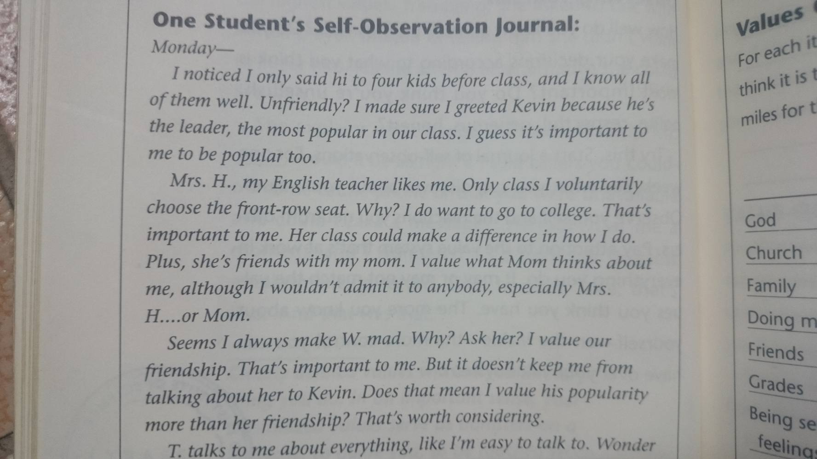


Slide 20


Slide 21
Values Quiz (VI, I, SW, UI)
Religion Status
Family Fun
Friends Home
Grades TV
University/school Health
Independence Money
Inner peace Respect from Others
My country Economic Security
Serving others Popularity

Slide 22
THANK YOU!
Any Questions?

